Slide 1
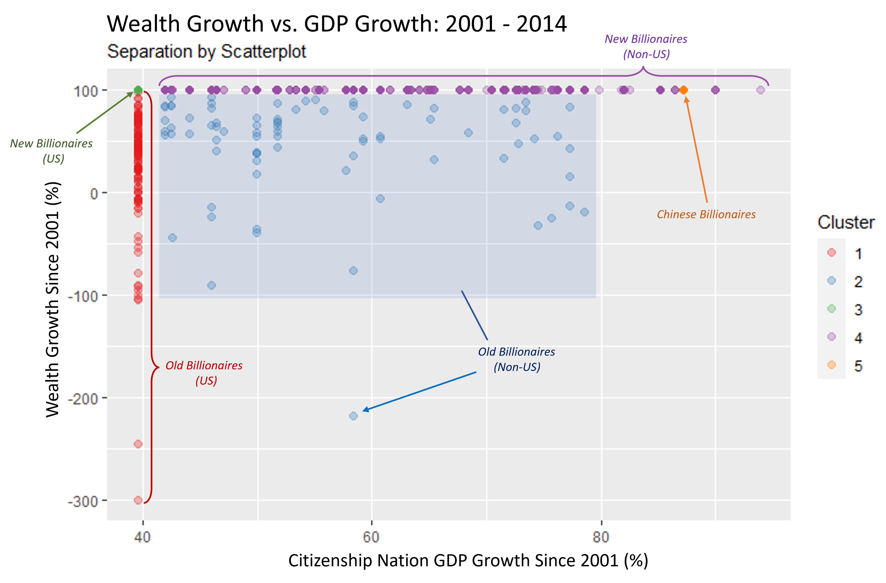
Cluster Analysis of Billionaires
The Data
A dataset of billionaires was compiled and published by Peterson Institute for International Economics, including wealth information in the years 2001 and 2014 in addition to personal information (age, gender, nation of citizenship) and descriptors for the nature of their wealth (inherited vs. earned, primary business sector, etc.).
Methodology
Two additional features were engineered to incorporate the amount of growth that occurred between 2001 and 2014 in a billionaire’s personal wealth and their citizenship nation’s GDP as a percentage of their respective 2014 values, as a way of capturing an individual’s wealth growth during that time period, as well as that of the economy surrounding them.
A density-based clustering algorithm was applied to this dataset to find and interpret different subclasses of billionaire.
Results
The two engineered variables turned out to be key for distinguishing subgroups of billionaires, as can be seen in the scatterplot to the right. 5 clusters were identified and interpreted as follows:
Long-time American billionaires
Long-time non-American billionaires
New American billionaires
New non-American billionaires
Chinese billionaires
Key Observations
Long-time non-American billionaires are the wealthiest on average.
While the US has the most billionaires of any single country, the largest cluster was populated by the non-American new billionaires.
The two wealthiest clusters included only 13% of all billionaires, mirroring the wealth inequality present in the global population.

Slide 2
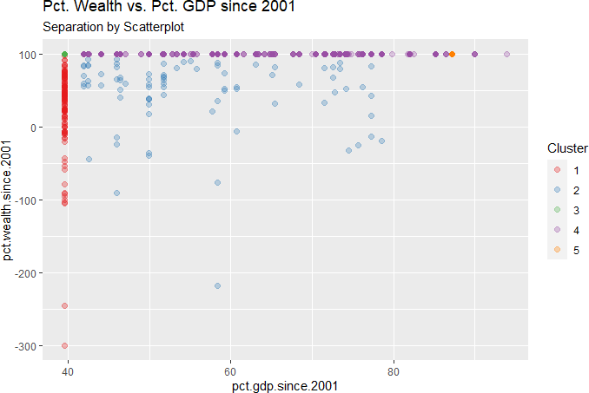
Wealth Growth vs. GDP Growth: 2001 - 2014
New Billionaires
(Non-US)
New Billionaires
(US)
Chinese Billionaires
Wealth Growth Since 2001 (%)
Old Billionaires
(Non-US)
Old Billionaires
(US)
Citizenship Nation GDP Growth Since 2001 (%)

